Slide 1

Orchestrating Metadata Enhancement Services: Introducing Lenny
Jon Phipps
Diane I. Hillmann
Cornell University Library (formerly NSDL)
Gordon Paynter
National Library of New Zealand
(formerly INFOMINE Project)

Slide 2
Introduction
Useful services depend on good metadata, but most metadata is not very good
Human created metadata is expensive
Automated crawling strategies are limited by:
  Accessibility barriers (rights issues, technical issues)
  Variable results with crawling technologies for non-text
Best metadata does not rely solely on information contained within the resource itself
  Ex.: Controlled vocabularies, descriptions, links

Slide 3
Metadata Quality Issues
Four categories of problems limit metadata usefulness:
  Missing data: elements not present
  Incorrect data: values not conforming to proper usage
  Confusing data: embedded html tags, improper separation of multiple elements, etc.
  Insufficient data: no indication of controlled vocabularies, formats, etc.

Slide 4
Metadata Quality Improvement
Some metadata improvement can be generalized across data sources
Many sources of data required more tailored quality improvement
Distinctions can be made between improvements to the metadata expression and additional information about the resource itself
Service based transformations had the potential to make the knowledge and expertise of service data managers available to downstream consumers of the data

Slide 5
Exposing Quality Information
Gradually changed orientation from “record” to “statement”--towards a resource-centric view
Given: Metadata statements vary in quality, and may be subjective
  Quality of statements can be determined to a great extent by knowledge of the source, and knowledge of the methodology used to create the statement
  Detailed provenance itself is a good indicator of quality metadata
Source of individual statements important and should be exposed

Slide 6
Metadata Quality Services
Metadata generation & augmentation
Metadata transformation (“safe” and “collection specific”)
Equivalence
Crosswalking (schema and vocabulary)
Persistence/archiving
Annotation
Metadata improvement and rating

Slide 7
Metadata Generation & Augmentation Services
Automated services (ex.: iVia):
  Generation of metadata from text
  Subject assignment and classification
  Identification of format, media type and extent
Human-based services:
  Assignments of subject, audience and genre
  Links to curriculum standards
  Evaluation and annotation

Slide 8
Metadata Transformation Services
Based on access to metadata itself, not the resource (ex.: Safe Transform Service)
  Identification of controlled vocabularies
  Spelling corrections
  Elimination of “promiscuous defaults” and empty values
  Elimination of whitespace and useless values (hyphens, etc. used as placeholders)

Slide 9
Equivalence Services
Establishing equivalence assertions
  Simple: same URL
  Complex: variant URL
Variance checking
References to cached or archived copies
References to alternative versions

Slide 10
Crosswalking Services
Crosswalking schema-to-schema
  Referencing schema versions and crosswalk versions
Crosswalking controlled vocabulary values
  Referencing crosswalk
Based on registry services

Slide 11
Persistence & Archiving Services
Provides links to available copies regardless of current network availability (ex.: Internet Archive)
References archived resources if no longer available in any current form
Provides archiving services to projects and pages no longer funded

Slide 12
Annotation Services
Associates reviews or comments about a resource to that resource
Provides ability to harvest annotations from central sources
Provides a place to generate annotations to available resources, and exposes those via OAI or RSS

Slide 13
Metadata Improvement & Rating
Provides evaluation and rating of metadata records, statements, etc.
Allows filtering or weighting at the statement level
Provides ability to profile metadata according to quality or reliability and harvest only highly rated records or statements

Slide 14
The Who and Where of Services
Many of the services we describe are useful to most metadata aggregators
No aggregator can afford to create many single purpose services closely coupled with a single aggregator
Shared, open services can provide a useful basis for improved metadata for all

Slide 15
“Conducting” Service Interactions
Order, timing, and response
Passive and active interactions
Human and automated triggers
Interaction parameters storage
“Freshness” and updating

Slide 16
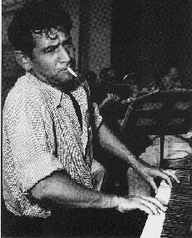
Typical Service Orchestration
Introducing Lenny…

Slide 17
Typical Service Orchestration
Editor initiates an iVia
Guided Crawl
message
Ivia
Service
Lenny notifies editor of
completion of crawl
message
Editor reviews results,
blacklists as necessary, notifies Lenny that crawl is complete
message
Lenny initiates OAI harvest and ingest
Ivia
Service
message
Lenny notifies Editor of success
message

Slide 18
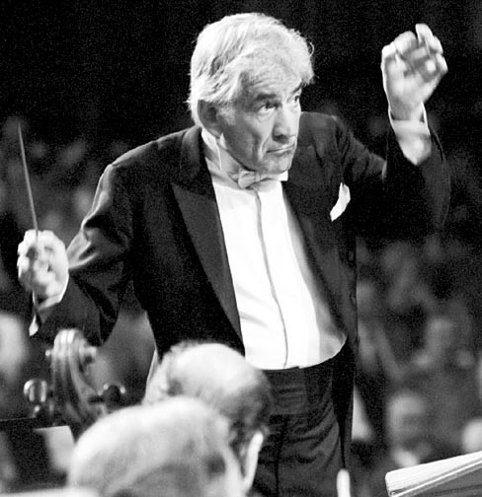
Typical Service Orchestration
Next…
Lenny initiates
Safe Transform Service
Service notifies Lenny
that it’s done
Lenny initiates OAI
harvest and ingest
Lenny notified of ingest success

Slide 19
Typical Service Orchestration
This pattern repeats for each service in the cue:
  Lenny checks schedule
  Lenny sends parameterized message to each service to start service interaction
  Services complete requested actions and send success/failure messages to Lenny
  Lenny processes messages and takes appropriate action

Slide 20
Orchestration Requirements
Most services are human- rather than machine-mediated
Lenny must understand and be able to execute parameterized service requests
Some programming required for each service interaction

Slide 21
Why not the
“Web Services Stack”?
We want to demonstrate the use of XML-over-HTTP services (like OAI)
Which Web Services stack -- IBM, Microsoft, OASIS?
Keep It Simple -- SOAP, WSDL solve essential problems but introduce complexity
Human-mediated service interactions are frequently required anyway

Slide 22
Conclusions
New role for “metadata aggregators”
  providing enhanced metadata for other services to re-use
  Integrating fragmentary metadata created by automated services
  Improving metadata in standard ways
  Exposing all relevant data in ways that allow consumers to evaluate quality and usefulness

Slide 23
Final Thoughts…
“This model of service provision holds much potential in an environment where persistent metadata quality issues threaten to overwhelm aggregators hoping to build services on top of harvested metadata. No single aggregator can fill in the quality gaps alone, but if metadata services are built to interoperate with a variety of aggregators using low barrier protocols like OAI-PMH, many can benefit from the work, freeing resources for new service development.”

